Slide 1
Resilience with Brilliance
St. Paul’s Prayer Stitchers
rise to the challenge

Slide 2
“See and touch the wounds of the world”
In a recent homily, Fr. George recounted a gospel story in which the risen Jesus exhorts us to “see and touch the wounds of the world.”
Prayer Stitchers, armed with knitting needles and crochet hooks, remain dedicated to that mission.

Slide 3
Resilience with Brilliance
In response to front-line health care worker distress,
Katie Robinson searched for a pattern for “face mask tabs” to help to relieve the pressure of the elastic on ears.
Katie made and donated 154 of these “tabs” to Wake-Med.

Slide 4
We thank God
for our family,
our St. Paul’s church,
our Prayer Stitcher ministry, and our community.

Slide 5
We thank God for the opportunities to provide prayerful support.

Slide 6
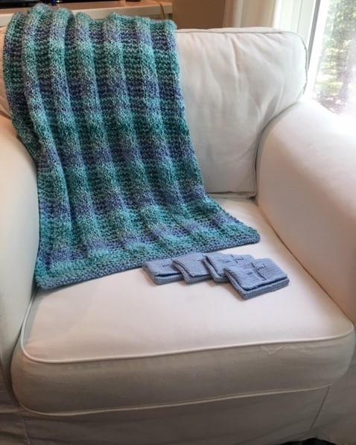
Prayer Shawl Blessing
May you, who receives this shawl, be cradled in hope, kept in joy, graced with peace and wrapped in love.

Slide 7
Prayer squares and prayer pockets for those facing difficult times, in need of prayer, comfort and encouragement

Slide 8
May God’s grace be upon this blanket. When your baby is wrapped in this blanket may they be cradled in hope, peace and love.
Photo submitted by Naomi Hammeke. Special thanks to Monty Moree’s family for use of heirloom cradle in display.

Slide 9
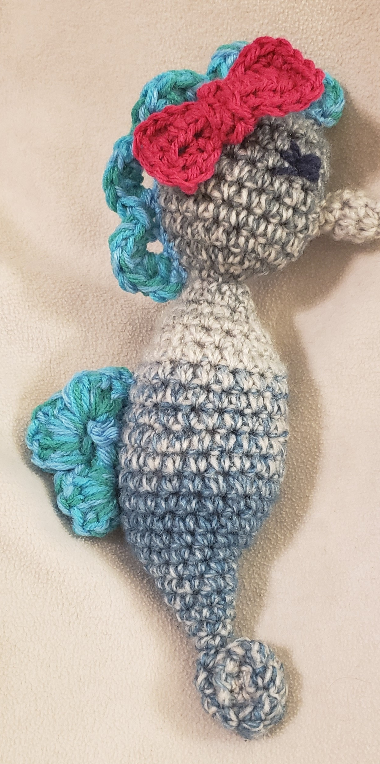
Some
comfort
In
challenging
times

Slide 10
Snuggling up in challenging times . . .
Shannon Robinson created this snuggly set to provide comfort

Slide 11
We thank God for community organizations that help families in need

Slide 12
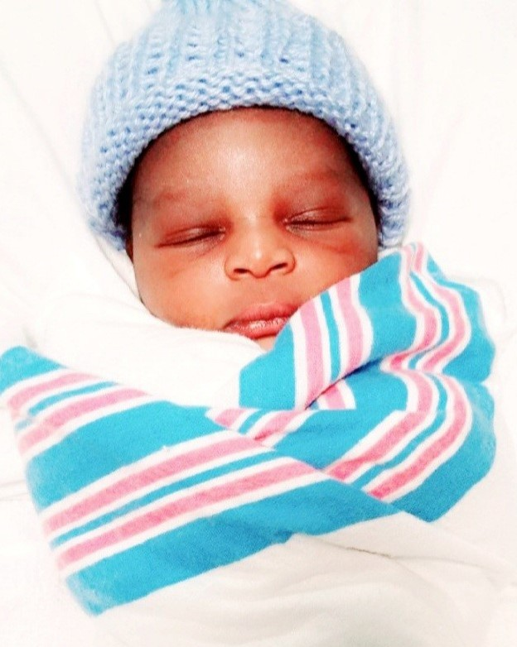
Beanies for Babies
“40% of the children served are in a neonatal intensive care unit (ICU) hospital ward”
Ronald McDonald House ongoing project.

Slide 13
Knitted item donations to local organization, With Love from Jesus, which provides annually 40,000 people with clothing and other items, prayer and hope.
Wendy Peck designs and creates beautiful homemade sweaters

Slide 14
Annual Homeless Initiative
We welcome contributions of generous donations to our ministry for outreach to the homeless.
Left to right, Carolyn Anderson, Sarah Benbow

Slide 15
Imagination flourishes, even at a social distance

Slide 16
Barbara Brickman’s creativity is an inspiration to us all. She made this nativity scene for a future St. Paul’s outreach fundraising effort.

Slide 17
Noah’s Ark
Pre-social distance
etiquette
of-course
Another design by Barbara Brickman

Slide 18
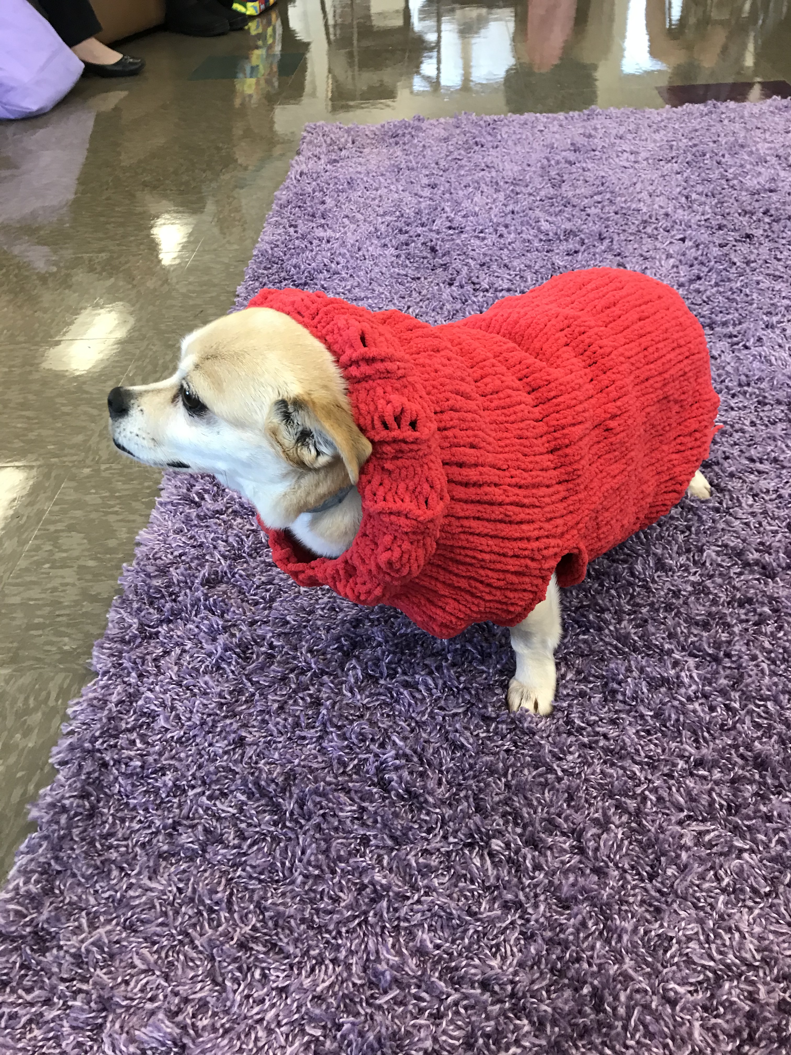
We must not forget our fur-babies
Miss Lulu sports her new sweater knitted by our very own Dr. Janet

Slide 19
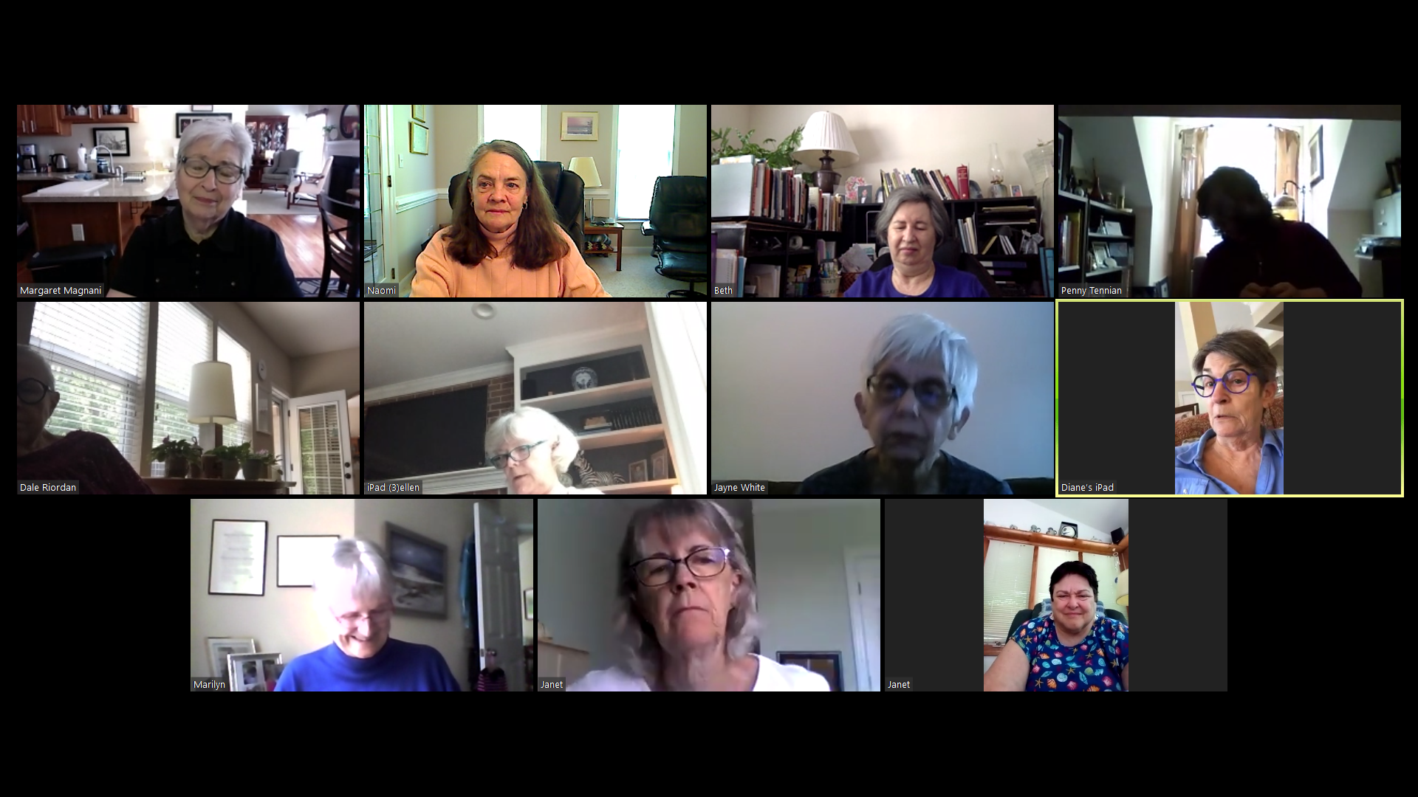
Zooming in . . . same time, different space.
We are now Zooming meetings
Please join us
Wednesday mornings at 10 AM
All are welcome!
prayerstitchers@stpaulscary.org

Slide 20
Prayer Stitcher Prayer
May our handiwork be blessed
May God touch our hands with love and
guide our needles and hooks with compassion
May God touch our hearts with peace and
guide our souls to freedom
May God guide our community with joy and
fill our world with hope
May our handiwork be blessed.
Amen
Adapted prayer by Knitting into the Mystery

